Slide 1




MONDAY AUTOMATION
TESTING PROJECT
Presented by: Mohammad Khayyo

Slide 2


About Me
23-year-old from Jerusalem
Graduated in Software engineering from the Azrieli College of Engineering Jerusalem
Enjoys hobbies such as traveling, and coding.
Enthusiastic about expanding knowledge and thriving in the field of automation.

Slide 3
Table Of Content
1. Introduction to Monday
UI,AI
2. What was done in the project !
STP, STD, TestRail, Bug Report, etc ...
3. Code OverView
4. Cl Build simulation using Jenkines

Slide 4
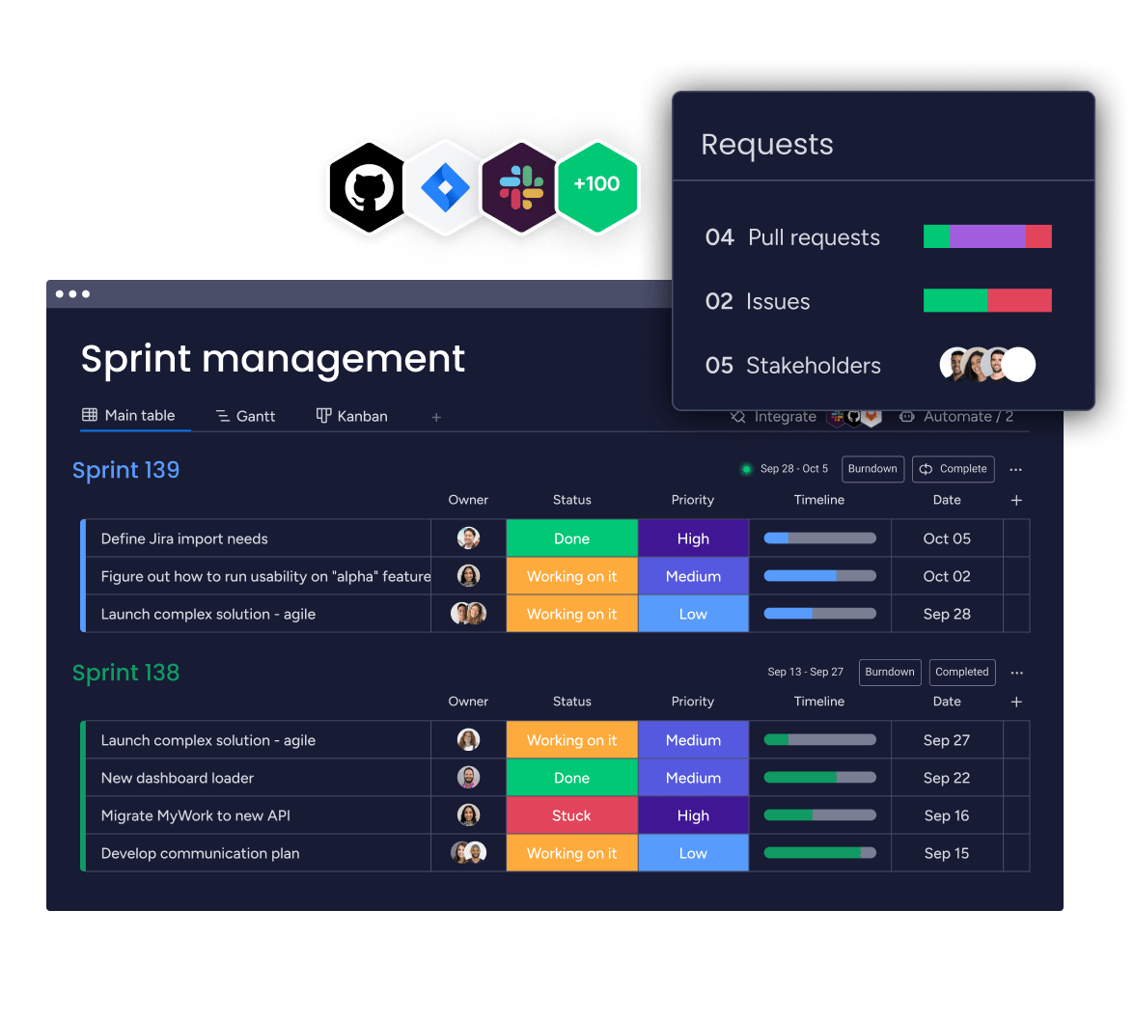
Introduction to Monday
A versatile Work OS that enables teams to manage projects and workflows with ease and efficiency.

Slide 5
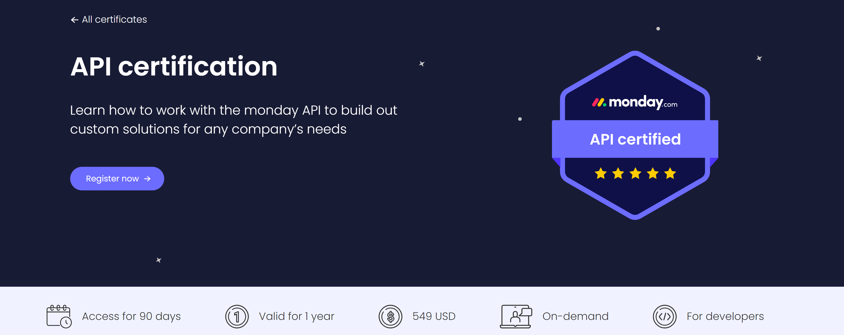
What is the Monday API?
The Monday API leverages GraphQL to provide developers with a robust and streamlined interface for interacting with Monday.com. This API facilitates precise data queries, updates, and real-time notifications, optimizing workflows and bolstering integrations for enhanced productivity.

Slide 6
STP
Software Test Plan: An overarching guide detailing the testing strategy, timeline, and resources.
STD
Software Test Description: Provides intricate details of each test case, including inputs and expected outcomes.

Slide 7
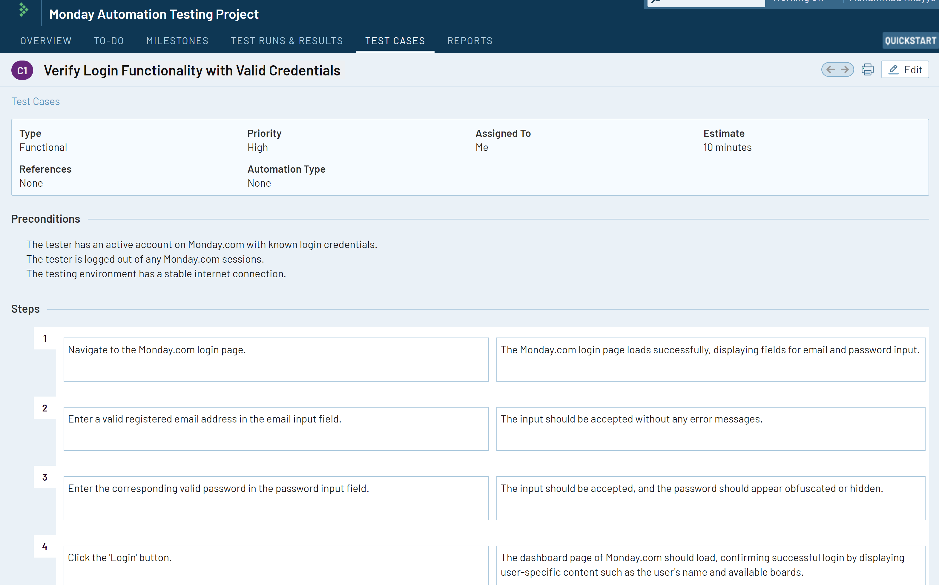
TestRail

Slide 8
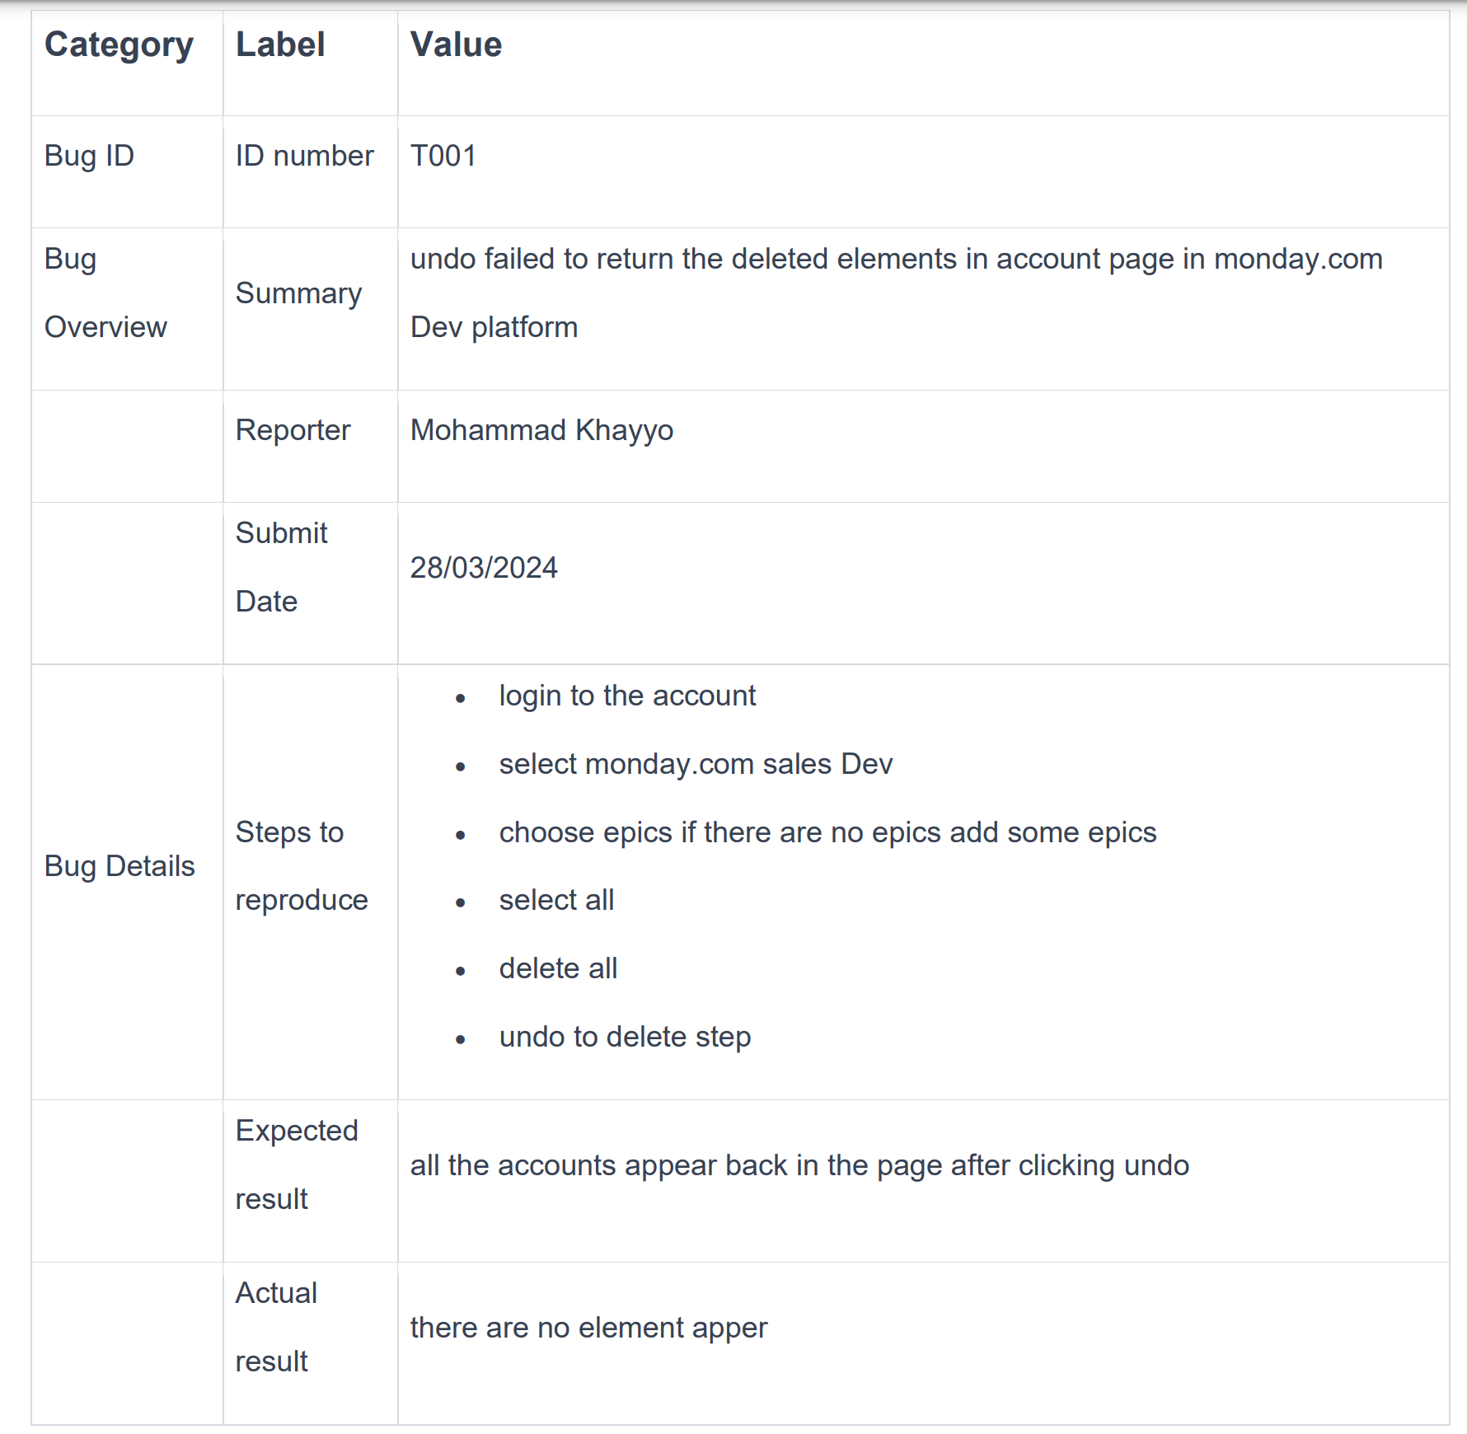
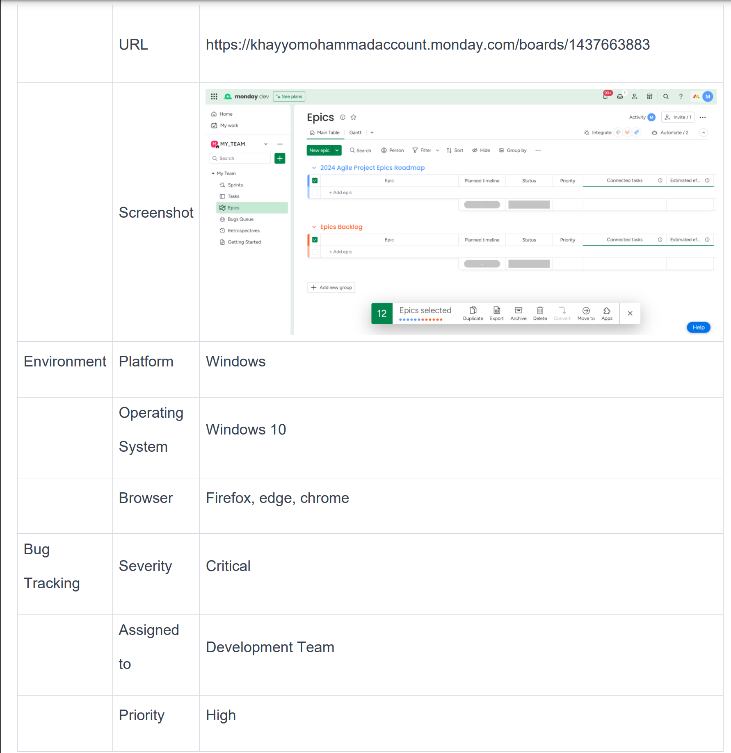
Bugs
Failed to retrieve the deleted epic using the UNDO button (UI test).
Bug Report :

Slide 9

What I Test?
E2E test
Negative / Positive tests
Functional and Non Functional tests

Slide 10
UI & API Testing Strategies
We employ Selenium Grid for UI testing to ensure cross-browser compatibility and GraphQL queries for backend API validation to maintain integrity and performance.

Slide 11
Code OverView

Slide 12
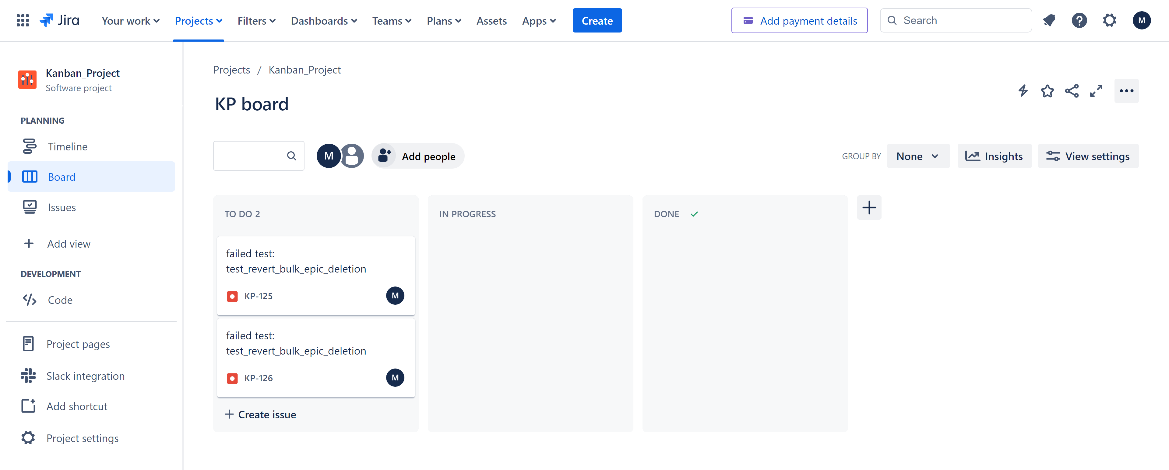
Jira
Jira is a popular project management tool used for issue tracking, agile project management, and workflow management.

Slide 13

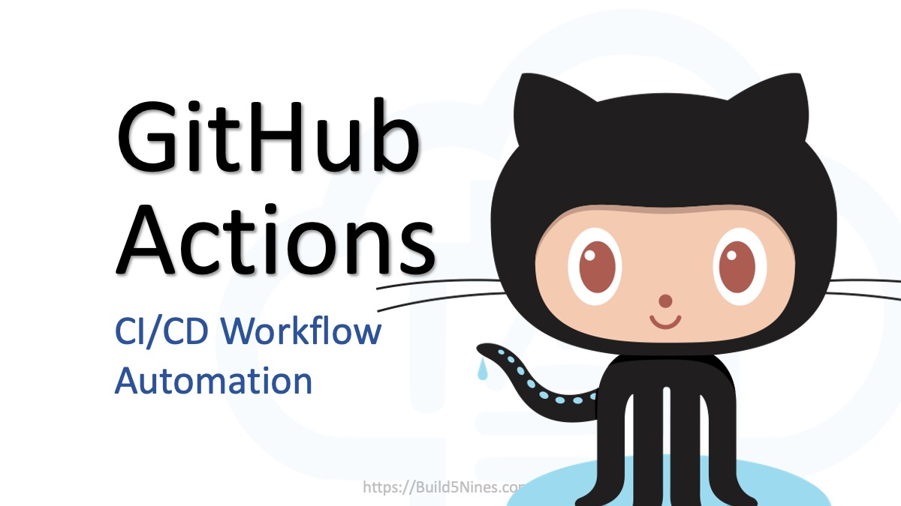
CI
Continuous Integration (CI) automates code merges, ensuring our software remains reliable and release-ready. Frequent integrations mean quick error detection and faster, more dependable delivery.

Slide 14
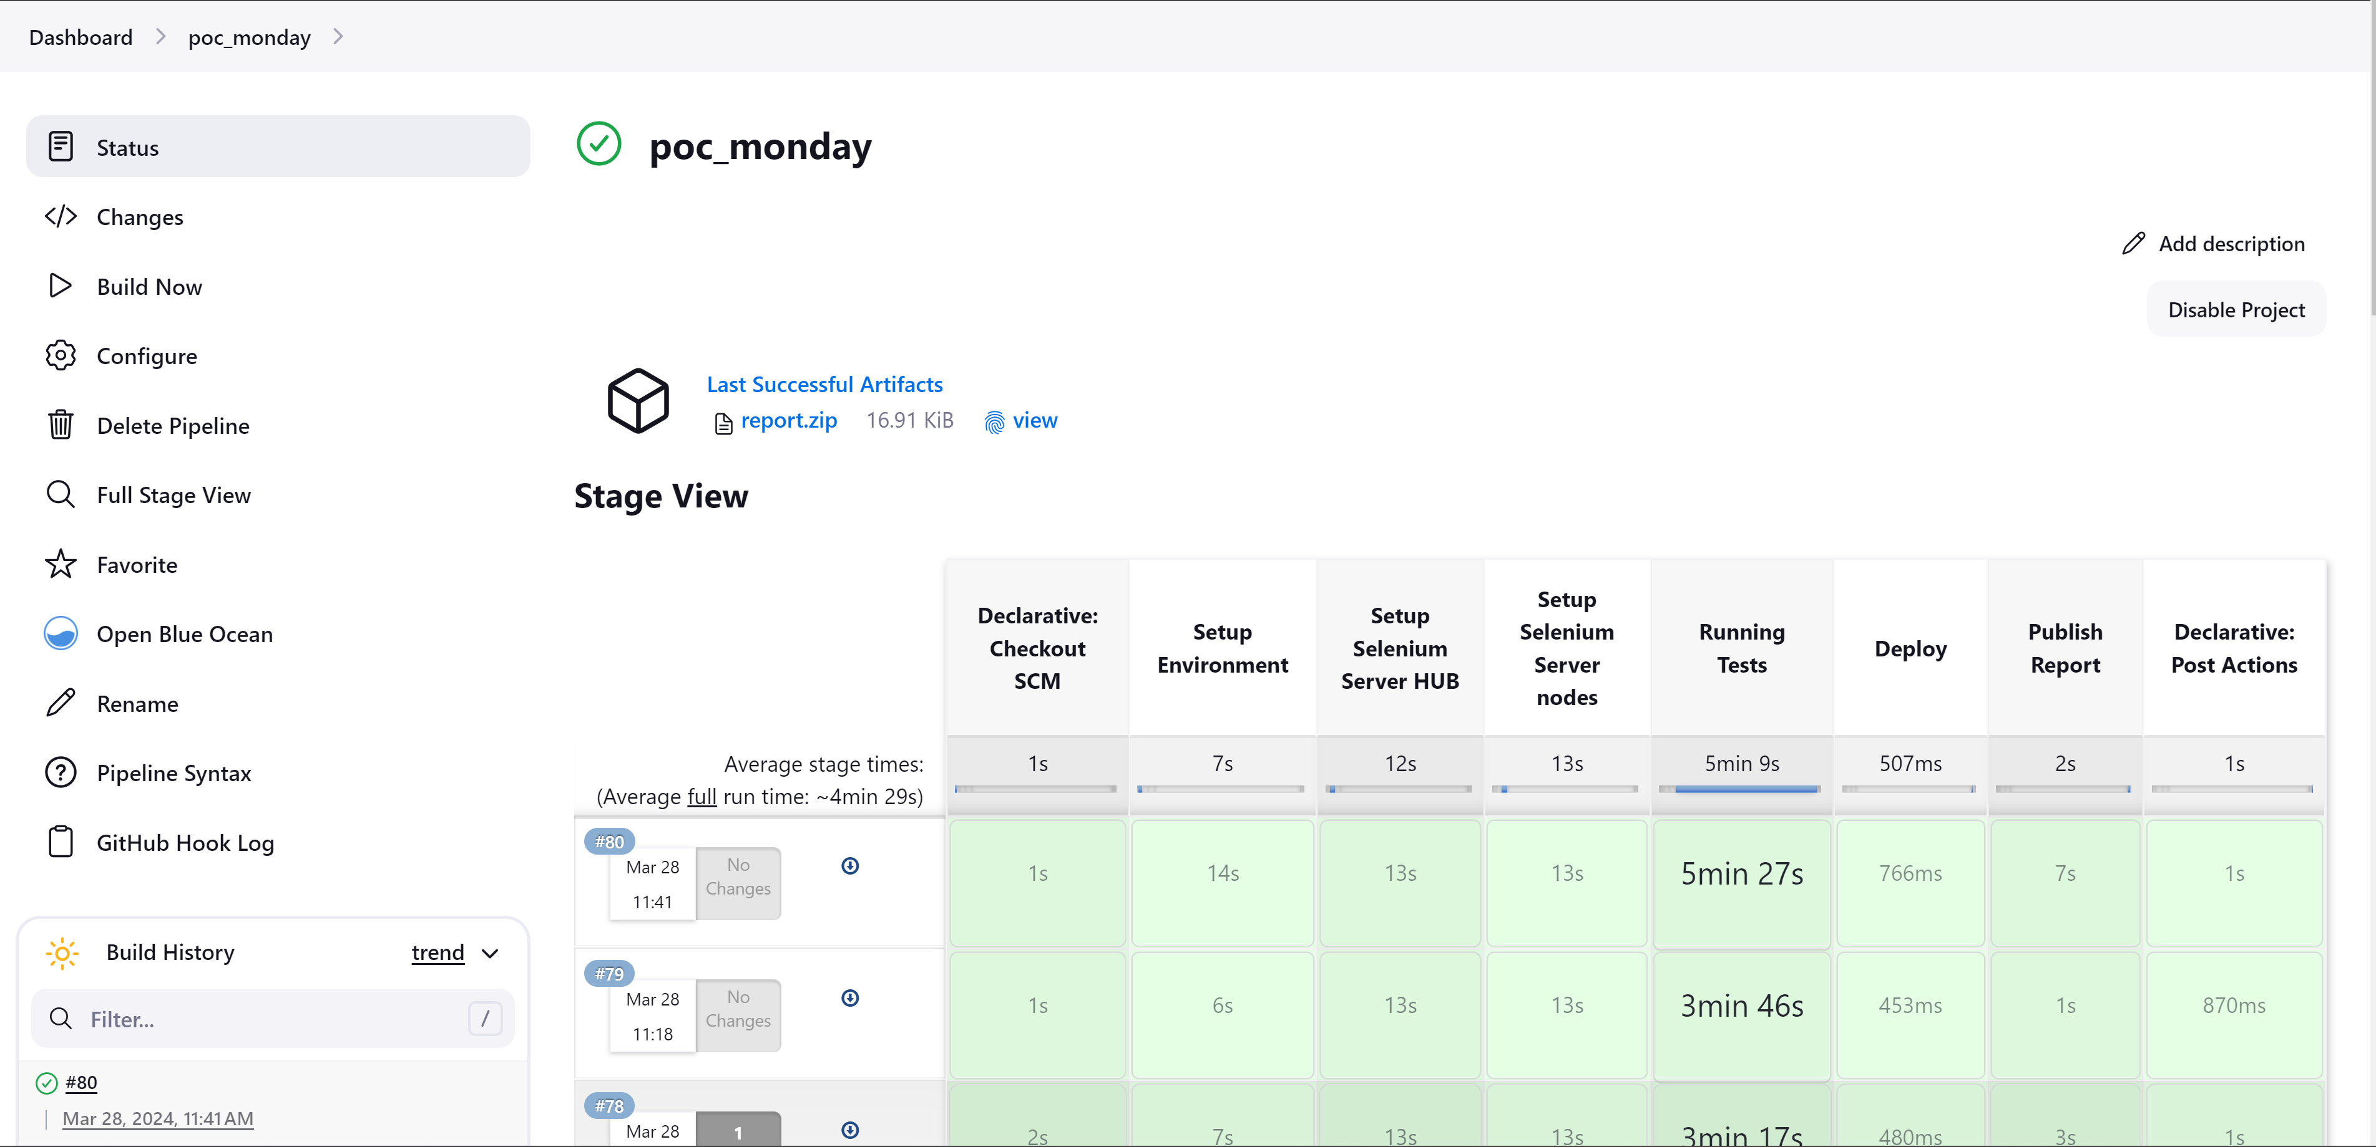
CI with Jenkins
Our project employs Jenkins for Continuous Integration, automating tests to ensure our code is always ready for release. It's crucial for rapid issue resolution and maintaining software quality.

Slide 15
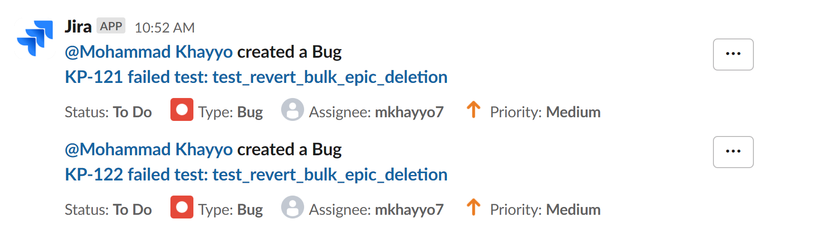
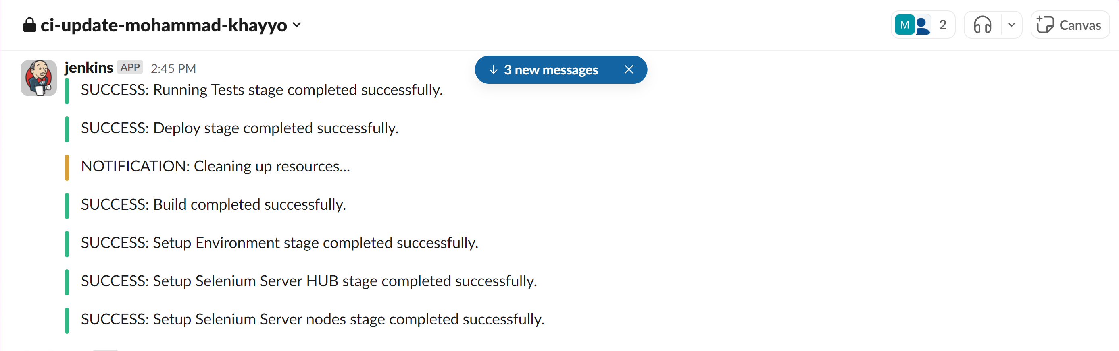
slack integration
Slack

Slide 16
QUESTIONS

Slide 17




THANK YOU
For watching this presentation
+972-58-687-6306
mohammadkhayyo@gmail.com
github.com/MohammadKhayyo

Slide 18
Table Of Content
Introduction
Project Goals and Objectives
About Monday.com
Automation Project Overview
UI & API Testing Strategies
Technology Stack
Challenges and Solutions
Integration with CI/CD
Q&A

Slide 19
Negative tests
Searching for a task that does not exist in the task table.

Slide 20
Non functional test
Capability test:
Running on different browsers using Selenium Grid.
Performance test:
Test how the system behaves under API request load.

Slide 21
TOOLS
SELENUIM GRID
POSTMAN
JIRA
JENKINS
TESTRAIL
GITHUB
SLACK

Slide 22


Table Of Content
Introduction
Monday API
Project Goals and Objectives
About Monday.com
Automation Project Overview
UI & API Testing Strategies
Technology Stack
Challenges and Solutions
Integration with CI/CD
Q&A

Slide 23
What is the Monday API?
{'error_code': 'ComplexityException',
'status_code': 429,
'error_message': 'Complexity budget exhausted, query cost 300001 budget remaining 9634 out of 1000000 reset in 49 seconds',
'error_data': {},
'errors': ['Complexity budget exhausted, query cost 300001 budget remaining 9634 out of 1000000 reset in 49 seconds'],
'account_id': 22122801}

Slide 24
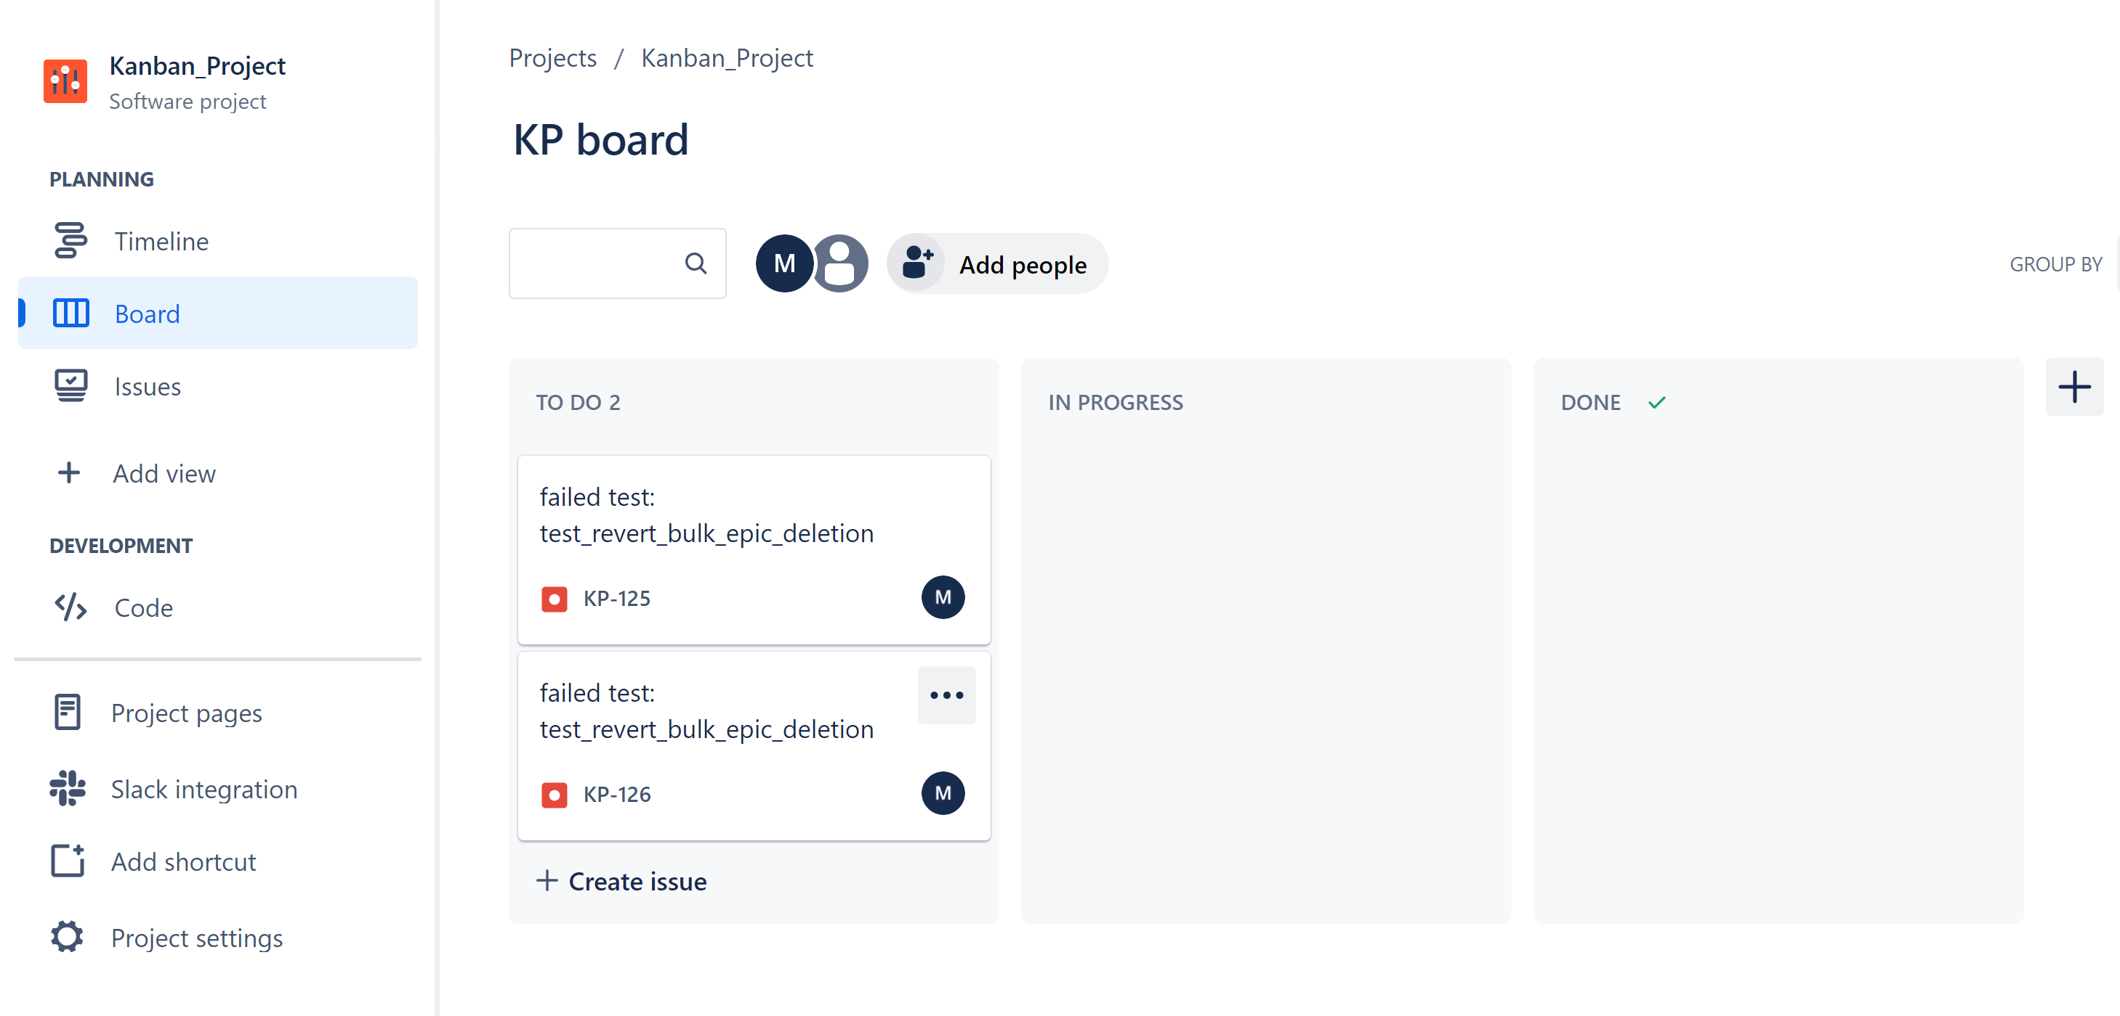
Bugs
Failed to retrieve the deleted epic using the UNDO button (UI test).
Incorrect status returned for group deletion (API test).
Bug Report :

